Slide 1
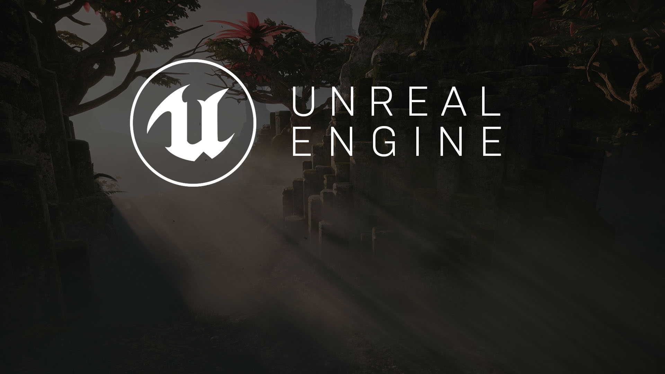
MULTIPLAYER #1
Basics of Multiplayer in UE

Slide 2
MULTIPLAYER OVERVIEW
Unreal Engine provides a lot of multiplayer functionality out of the box, and it's easy set up a basic Blueprint game that works over a network.
It’s easy to dive in and start playing mutliplayer. Most of the logic to make basic multiplayer work is thanks to the built-in networking support in the Character class, and its CharacterMovementComponent.

Slide 3

To add multiplayer functionality to your game, it's important to understand the roles of the major gameplay classes that are provided by the engine and how they work together - and especially, how they work in a multiplayer context:
GameInstance
GameMode
GameState
Pawn (and Character, which inherits from Pawn)
PlayerController
PlayerState
Gameplay framework review

Slide 4
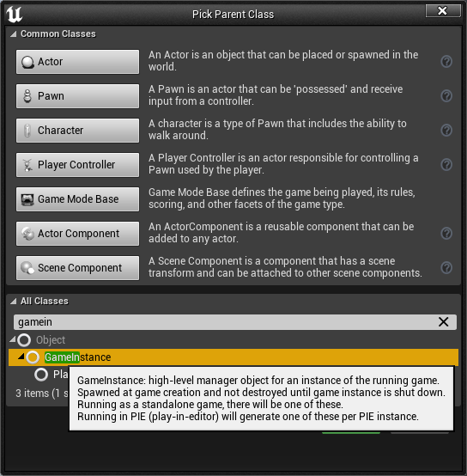
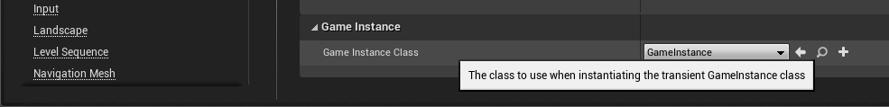
The GameInstance exists for the duration of the engine's session, meaning that it is created when the engine starts up and not destroyed or replaced until the engine shuts down.
A separate GameInstance exists on the server and on each client, and these instances do not communicate with each other.
Because the GameInstance exists outside of the game session and is the only game structure that exists across level loads, it is a good place to store certain types of persistent data, such as:
Lifetime player statistics (e.g. total number of games won)
Account information (e.g. locked/unlocked status of special items)
List of maps to rotate through in a competitive game UT.
Character creation related data and stats.
GameInstance

Slide 5
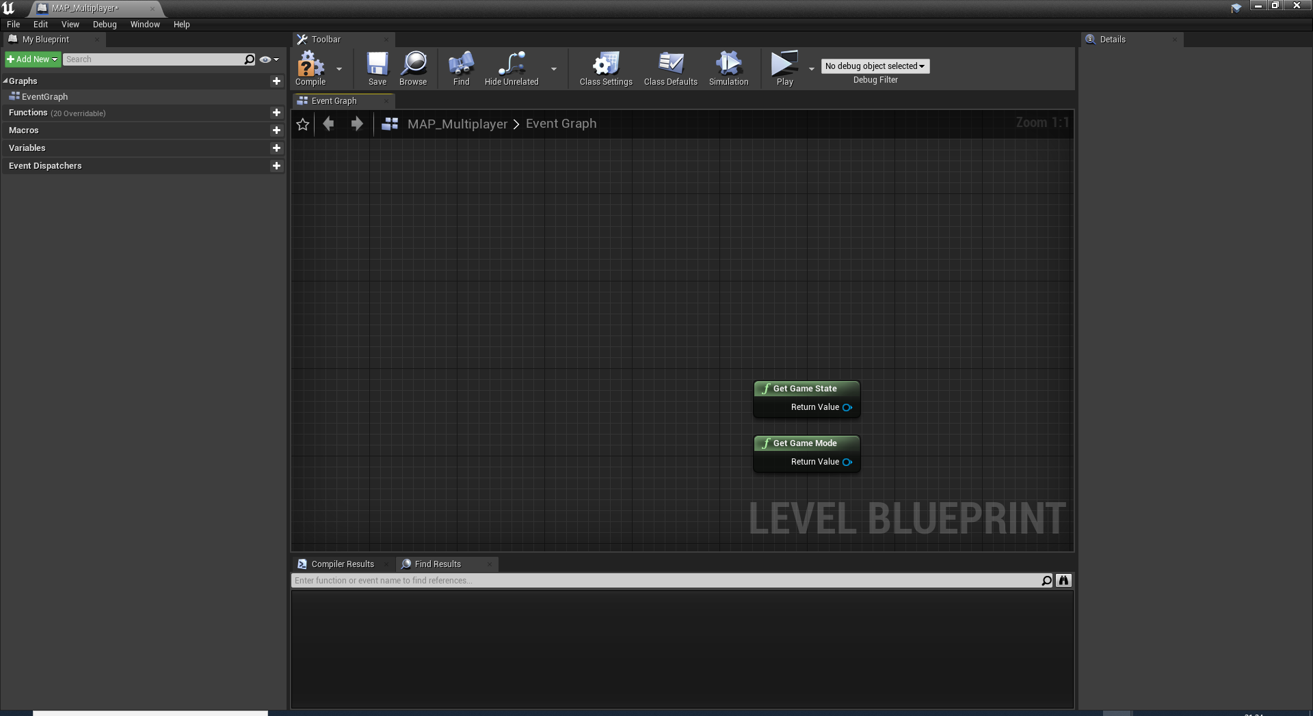
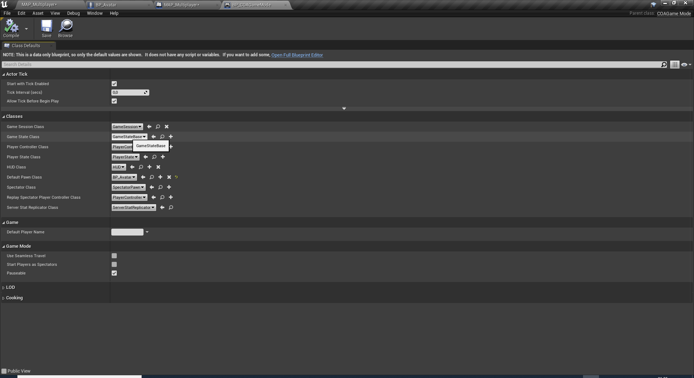
The GameMode object only exists on the server.
It generally stores information related to the game that clients do not need to know explicitly. For example, if a game has special rules like "rocket launchers only", the clients may not need to know this rule, but when randomly spawning weapons around the map, the server needs to know to pick only from the "rocket launcher" category.
The GameState exists on the server and the clients, so the server can use replicated variables on the GameState to keep all clients up-to-date on data about the game.
Information that is of interest to all players and spectators, but isn't associated with any one specific player, is ideal for GameState replication.
As an example, a baseball game could replicate each team's score and the current winning via the GameState.
GameMode & GameState

Slide 6
The GameMode object only exists on the server.
It generally stores information related to the game that clients do not need to know explicitly. For example, if a game has special rules like "rocket launchers only", the clients may not need to know this rule, but when randomly spawning weapons around the map, the server needs to know to pick only from the "rocket launcher" category.
The GameState exists on the server and the clients, so the server can use replicated variables on the GameState to keep all clients up-to-date on data about the game.
Information that is of interest to all players and spectators, but isn't associated with any one specific player, is ideal for GameState replication.
As an example, a baseball game could replicate each team's score and the current winning via the GameState.
GameMode & GameState

Slide 7
One PlayerController exists on each client per player on that machine.
These are replicated between the server and the associated client, but are not replicated to other clients, resulting in the server having PlayerControllers for every player, but local clients having only the PlayerControllers for their local players.
PlayerControllers exist while the client is connected, and are associated with Pawns, but are not destroyed and respawned like Pawns often are.
They are well-suited to communicating information between clients and servers without replicating this information to other clients, such as the server telling the client to ping its minimap in response to a game event that only that player detects.
A PlayerState will exist for every player connected to the game on both the server and the clients.
This class can be used for replicated properties that all clients, not just the owning client, are interested in, such as the individual player's current score in a free-for-all game.
Like the PlayerController, they are associated with individual Pawns, and are not destroyed and respawned when the Pawn is.
PlayerControllers & PlayerStates

Slide 8
Pawns (including Characters) will also exist on the server and on all clients, and can contain replicated variables and events.
The decision of whether to use the PlayerController, the PlayerState, or the Pawn for a certain variable or event will depend on the situation, but the main thing to keep in mind is that the PlayerController and PlayerState will persist as long as:
the owning player stays connected to the game
the game doesn't load a new level
..whereas a Pawn may not. For example, if a Pawn dies during gameplay, it will usually be destroyed and replaced with a new Pawn, while the PlayerController and PlayerState will continue to exist and will be associated with the new Pawn once it finishes spawning.
The Pawn's health, therefore, would be stored on the Pawn itself, since that is specific to the actual instance of the Pawn and should be reset when the Pawn is replaced with a new one.
Pawns

Slide 9
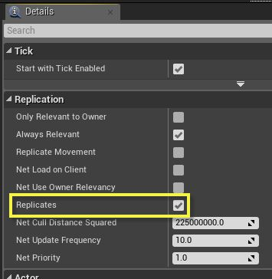
ACTOR REPLICATION
The core of the networking technology in UE4 is actor replication.
An actor with its "Replicates" flag set to true will automatically be synchronized from the server to clients who are connected to that server.
An important point to understand is that:
Actors are only replicated from the server to the clients!!
It's not possible to have an actor replicate from a client to the server. Of course, clients still need to be able to send data to the server, and they do this through replicated "Run on server" events.

Slide 10
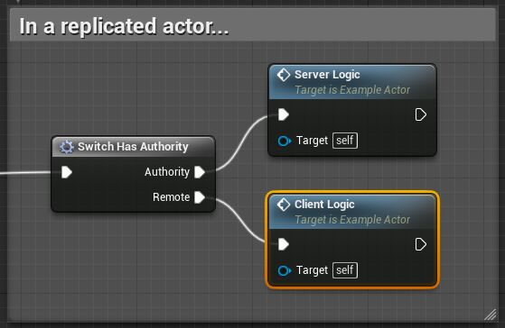
AUTHORITY
For every actor in the world, one of the connected players is considered to have authority over that actor.
For every actor that exists on the server, the server has authority over that actor - including all replicated actors.
As a result, when the Has Authority function is run on a client, and the target is an actor that was replicated to them, it will return false.
You can also use the Switch Has Authority convenience macro as a quick way to branch for different server and client behavior in replicated actors.

Slide 11
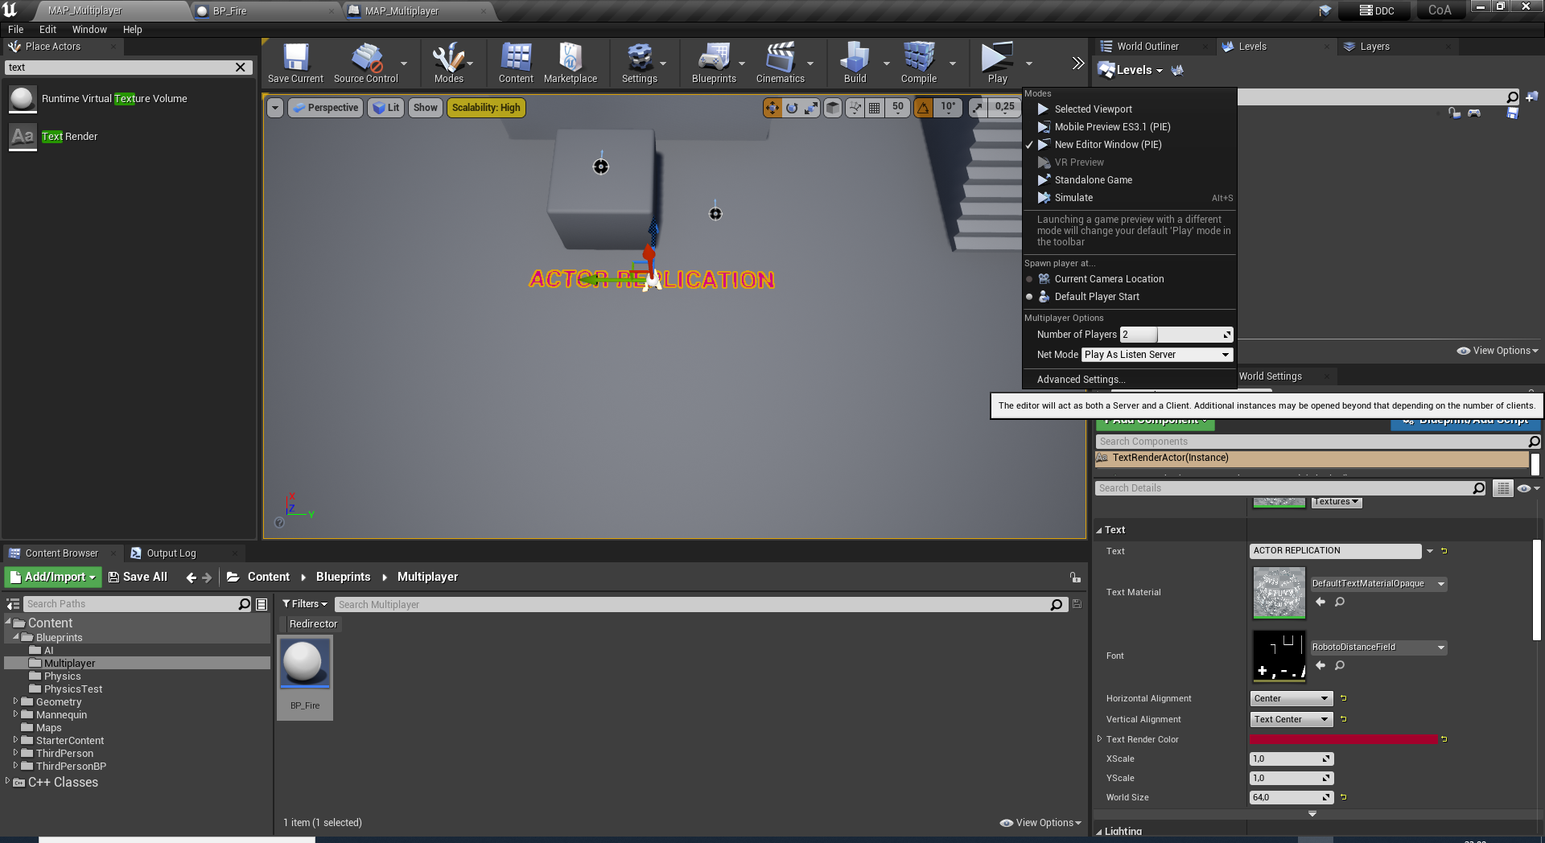
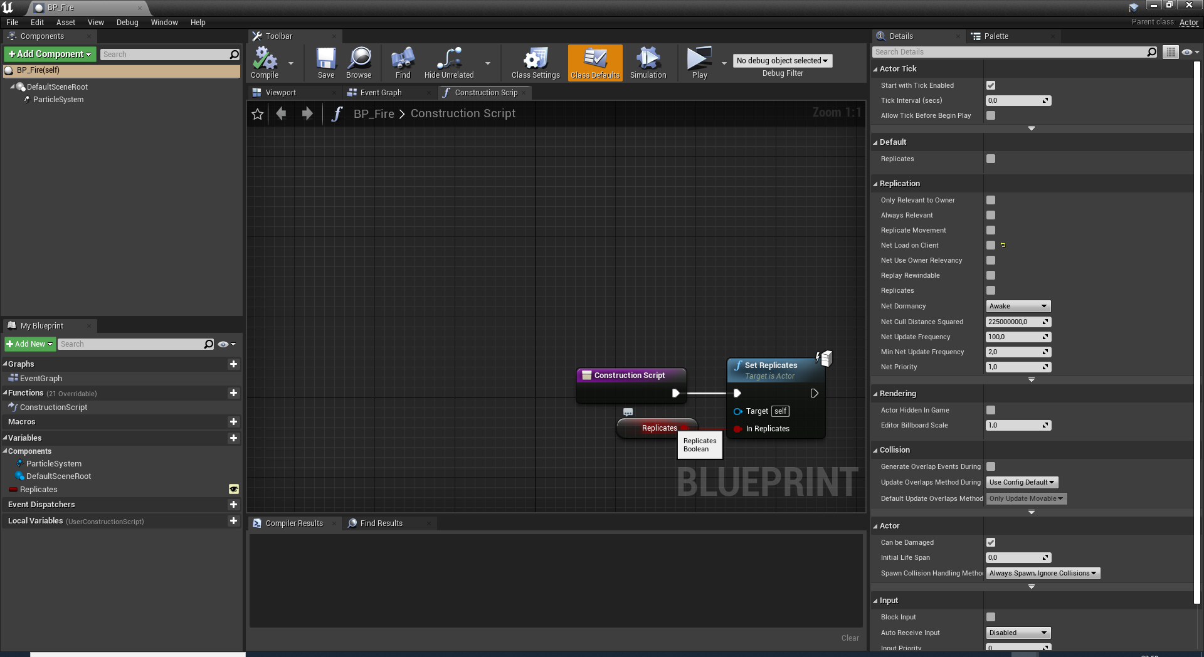
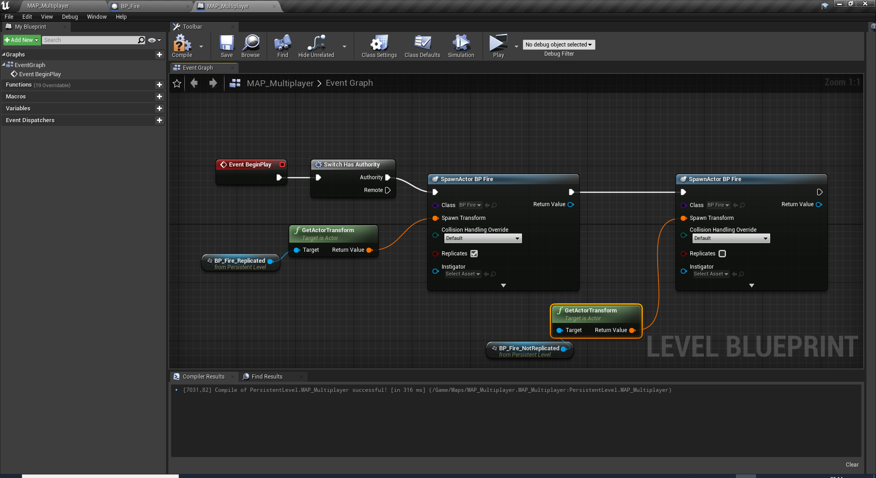
Create 2 sepreate TargetPoint actors on the map.
Create BP_Fire blueprint and add a fire particle on it.
Add SetReplicates node with a «Exposed On Spawn» Replicates variable at blueprint’s construction script.
ACTOR REPLICATION TEST

Slide 12
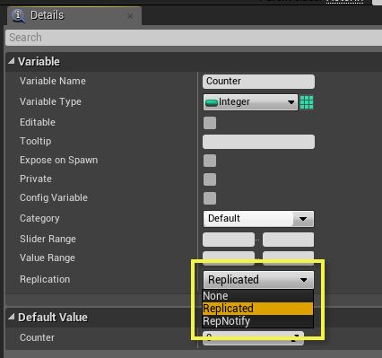
REPLICATION
OF VARIABLES
In the details panel of variables on your actors, there is a Replication drop-down that lets you control how your variables are replicated, if at all.

Slide 13
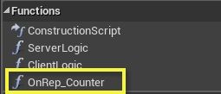
Option | Description
None | This is the default for new variables, and means the value will not be sent over the network to clients.
Replicated | When the server replicates this actor, it will send this variable to clients. The value of the variable on the receiving client will update automatically, so that the next time it's accessed, it will reflect what the value was on the server. Of course, when playing over a real-world network, the updates will be delayed by an amount of time dependent on the network's latency. Remember that replicated variables only go in one direction, from the server to the client! To send data from a client to the server, see the "Events" section.
RepNotify | The variable will be replicated as in the Replicated option, but in addition, an OnRep_<variable name> function will be created in your Blueprint. This function will be called by the engine automatically on the client and the server whenever the value of this variable changes. You're free to implement this function however you'd like, as needed by your game.
REPLICATION
OF VARIABLES
In the details panel of variables on your actors, there is a Replication drop-down that lets you control how your variables are replicated, if at all.

Slide 14
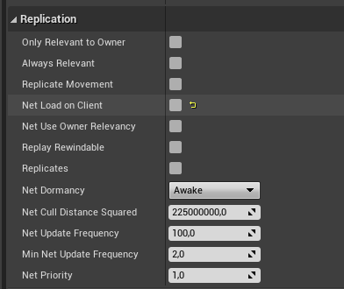
REPLICATION PROPERTIES
OF AN ACTOR
Many of the variables in the engine's built-in classes already have replication enabled, so that many features work automatically in a multiplayer context.
Replicates
Net Cull Distance Squared
Net Update Frequency
Min Next Update Frequency

Slide 15

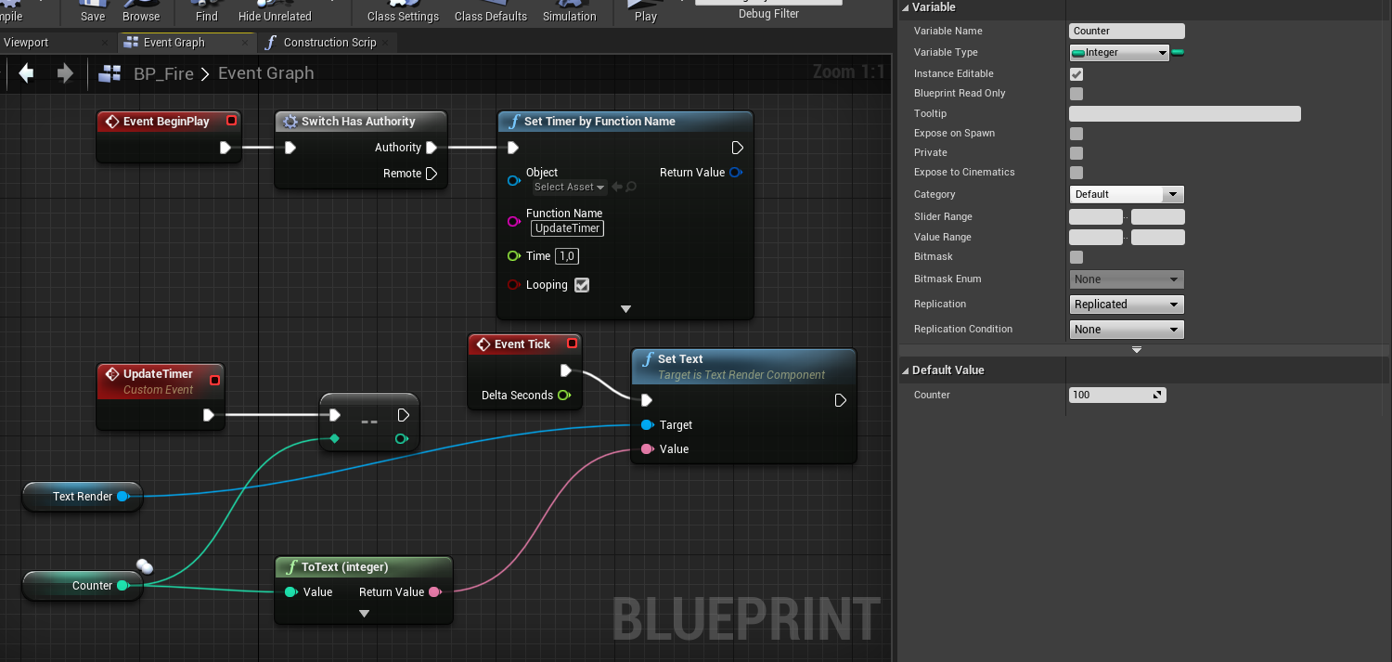
VARIABLE REPLICATION TEST

Slide 16
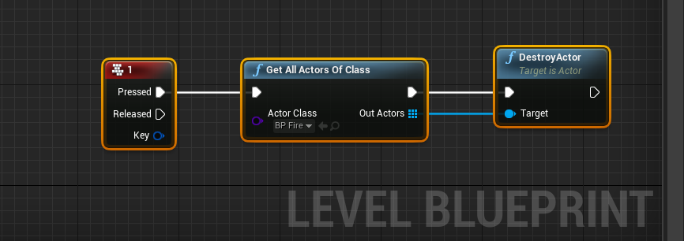
The situation is similar for destroying replicated actors: if the server destroys one, all clients will destroy their respective copies as well.
Clients are free to destroy actors for which they have authority - that is, actors they have spawned themselves - since these are not replicated to other players and wouldn't have any affect on them.
If a client tries to destroy an actor for which they are not the authority, the destroy request will be ignored. The key point here is the same for spawning actors: if you need to destroy a replicated actor, destroy it on the server.
This this both on client and the server:
SPAWNING AND DESTROYING
When a replicated actor is spawned on the server, this is communicated to clients, and they will also automatically spawn a copy of that actor.
But since, in general, replication doesn't occur from clients to the server, if a replicated actor is spawned on a client, that actor will only exist on the client that spawned it.
Neither the server nor any other client will receive a copy of the actor. The spawning client will, however, have authority over the actor.
This can still be useful for things like cosmetic actors that don't really have an effect on gameplay, but for actors that do have an effect on gameplay and should be replicated, it's best to make sure they are spawned on the server.

Slide 17
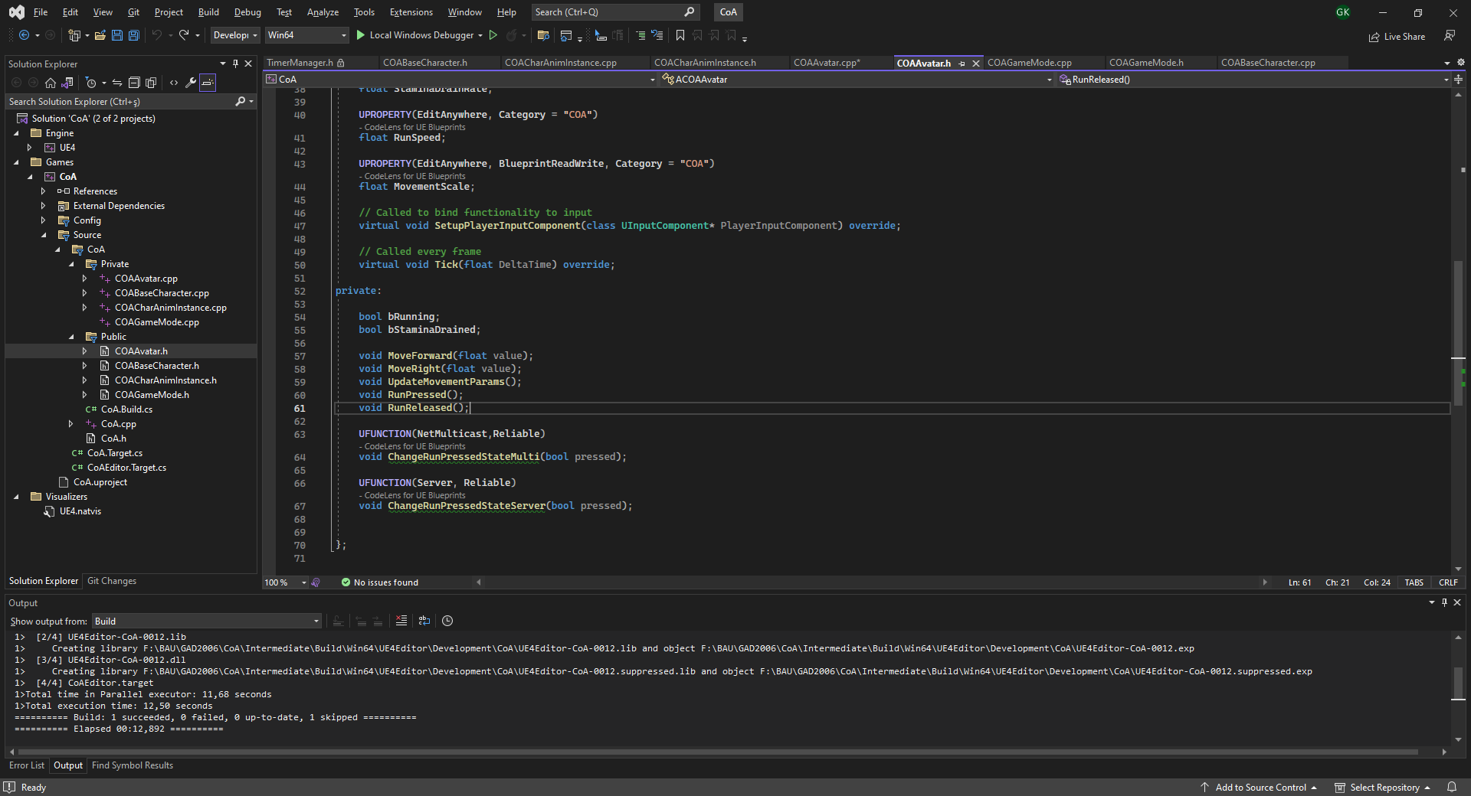
EVENT REPLICATION (RPC)
In addition to replicating actors and their variables, you can also run events across the clients and the server.
RPC (Remote Procedure Call). Replicated events in Blueprints essentially compile down to RPCs inside the engine – RPC is what they're usually called in C++.

Slide 18
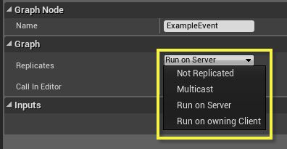
For our purposes, know that "Run on server" events can only be invoked from actors (or their components) which the client owns. Usually, this means you can only send "Run on server" events from the following actors, or from a component of one of the actors:
The client's PlayerController itself
A Pawn that the client's PlayerController possesses
The client's PlayerState.
Likewise, for a server sending "Run on owning client" events, those events should also be invoked on one of these actors. Otherwise, the server won't know which client to send the event to, and it will only run on the server!
OWNERSHIP
An important concept to understand when working on multiplayer, and especially with replicated events, is which connection is considered to be the owner of a particular actor or component.

Slide 19
Option | Description
Not Replicated | This is the default, and means there will be no replication for this event. If it is invoked on a client, it will only run on that client, and if it is invoked on the server, it will only run on the server.
Multicast | If a multicast event is invoked on the server, it will be replicated to all connected clients - regardless of which connection owns the target object. If a client invokes a multicast event, it will be treated as if it wasn't replicated, and it will only run on the client that invoked it.
Run on Server | If this event is invoked from the server, it will only run on the server. If it's invoked from a client, with a target that the client owns, it will be replicated to and run on the server. "Run on Server" events are the primary method for clients to send data to the server.
Run on Owning Client | If invoked from the server, this event will run on the client who owns the target actor. Since the server can own actors itself, a "Run on Owning Client" event may actually run on the server, despite its name. If invoked from a client, the event will be treated as if it isn't replicated, and it will only run on the client that invoked it.
EVENT REPLICATION
Multicast
Run on Server
Run on Owning Client

Slide 20
If the event is invoked from the server, given the target in the left-hand column, it will run on...
 | Not replicated | Multicast | Run on Server | Run on Owning Client
Client-owned target | Server | Server and all clients | Server | Target's owning client
Server-owned target | Server | Server and all clients | Server | Server
Unowned target | Server | Server and all clients | Server | Server

Slide 21
If the event is invoked from a client, given the target in the left-hand column, it will run on...
 | Not replicated | Multicast | Run on Server | Run on Owning Client
Target owned by invoking client | Invoking client | Invoking client | Server | Invoking client
Target owned by a different client | Invoking client | Invoking client | Dropped | Invoking client
Server-owned target | Invoking client | Invoking client | Dropped | Invoking client
Unowned target | Invoking client | Invoking client | Dropped | Invoking client

Slide 22
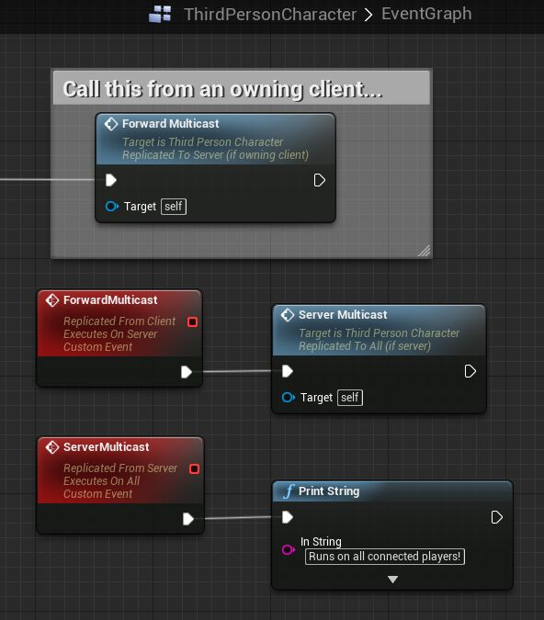
A pattern that comes up pretty often is that a client performs some action in the world, notifies the server about the action via a "Run on server" event, and in the implementation of that event, the server updates some replicated variables based on the action.
Then the other clients, who did not perform the action, still see the result of the action via the replicated variables.
In addition, any clients who join-in-progress after the action has occurred will also see the correct state of the world, since they receive the most recent value of the replicated variables from the server.
If the server had instead only sent an event, the join-in-progress players wouldn't know about the action that was performed!
JOIN-IN PROGRESS
One thing to keep in mind when using replicated events to communicate game state changes is how they interact with a game that supports join-in-progress.
If a player joins a game in progress, any replicated events that occurred before the join will not be executed for the new player.
The takeaway here is that if you want your game to work well with join-in-progress, it's usually best to synchronize important gameplay data via replicated variables.

Slide 23
RELIABILITY
For any replicated event, you can choose whether it is Reliable or Unreliable.
Reliable events (TCP based) are guaranteed to reach their destination (assuming the ownership rules above are followed), but they introduce more bandwidth, and potentially latency, to meet this guarantee.
Try to avoid sending reliable events too often, such as on every tick, since the engine's internal buffer of reliable events may overflow - when this happens, the associated player will be disconnected!
Unreliable events (UDP Based) work as their name implies - they may not reach their destination, in case of packet loss on the network, or if the engine determines there is a lot of higher-priority traffic it needs to send, for example. As a result, unreliable events use less bandwidth than reliable events, and they can be called safely more often.

Slide 24
COA MULTIPLAYER SUPPORT
We have these issues to address:
Why the client players can not switch to running state properly? Is there a speed-hack built-in system?
Why attacking state is not synching through all players?
Why the client player can not damage other players?

Slide 25
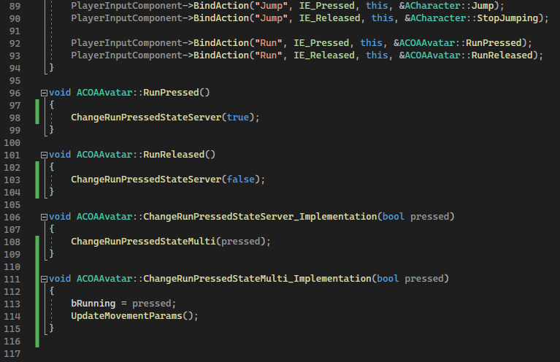
COA RUNNING
CharacterMovementComponent and Character class handles movement and rotation updates.
However, running is not supported… Yet..
ChangeRunPressedStateServer() => Used by clients to ask server for permission to change into running mode.
When the message (RPC) reaches at the server, server broadcasts every clients that the message sending client started running by calling ChangeRunPressedStateMulti()

Slide 26
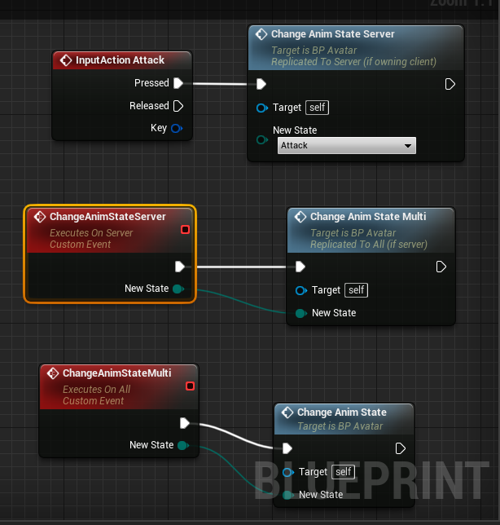
COA ATTACKING
We need to modify Attack state not to damage players on client side.
It should be server’s duty to simulate the attack start-up timer and inflict the damage at any player and let all client know that a client is being damaged or getting killed.
SOLUTION:
Likewise, we are going to add 2 new events with «Run on Server» and «Multicast» replication properties.

Slide 27
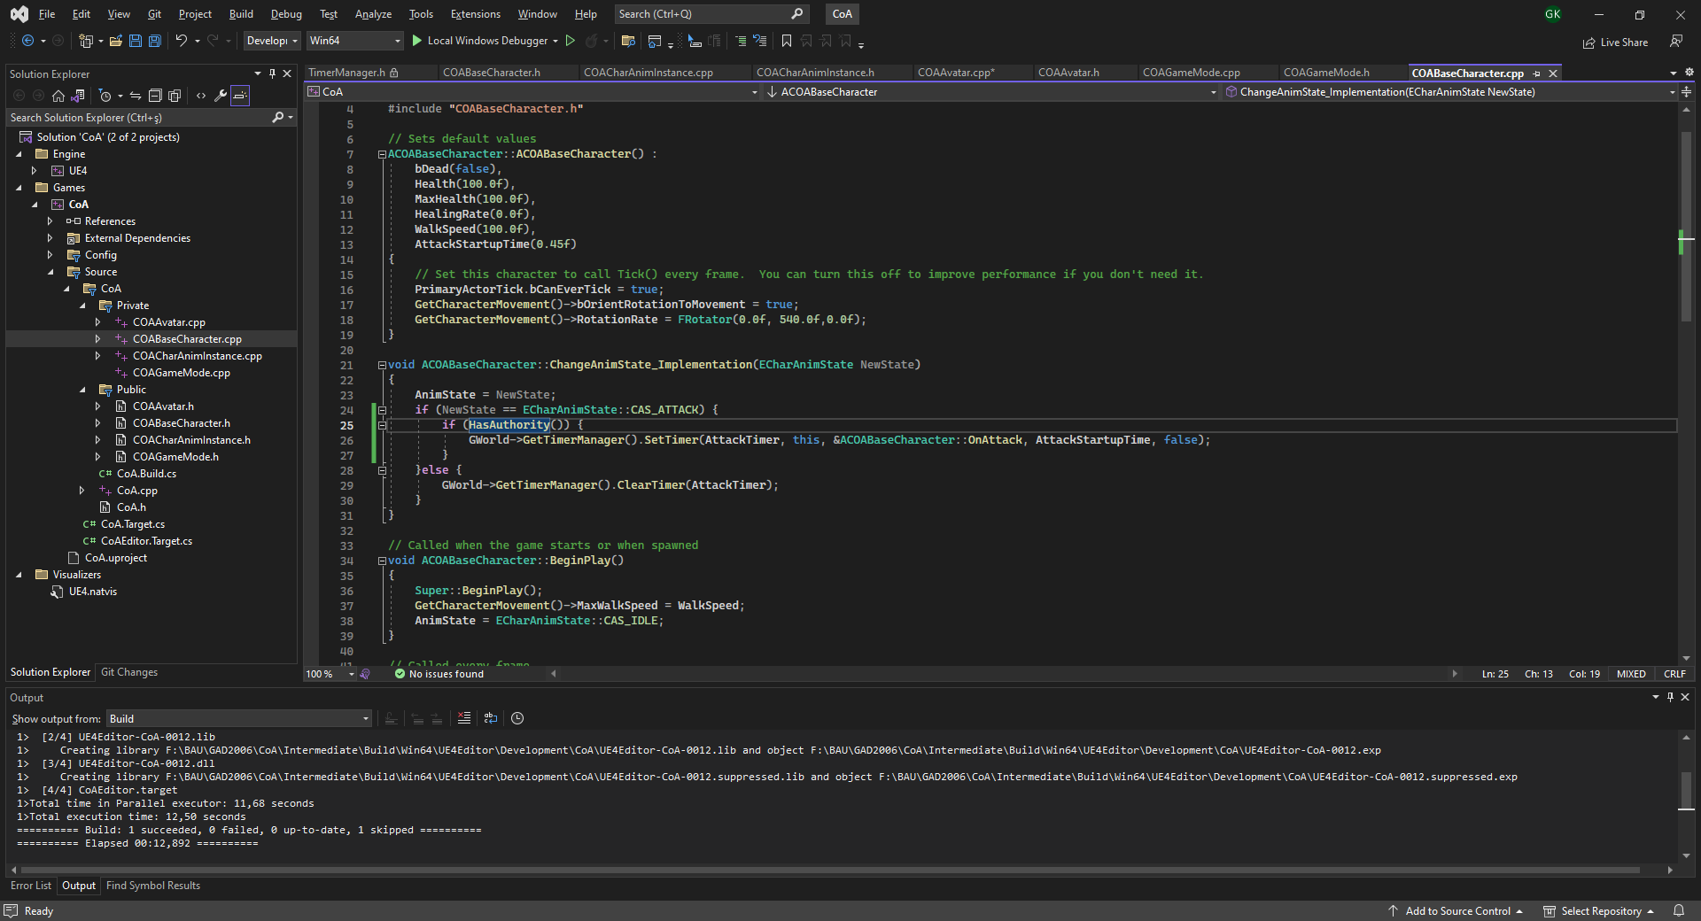
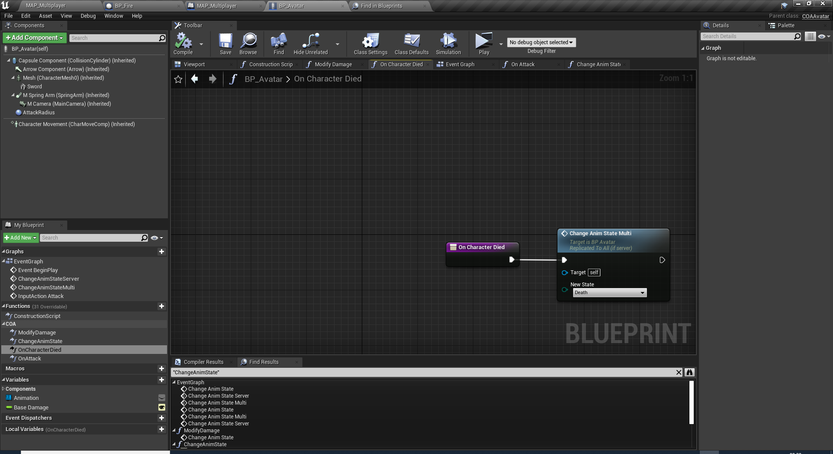
COA ATTACKING
We can prevent unnecessary OnAttack calls on clients by limiting the timer only start when the BaseCharacter HasAuthority(). Which means only when run on the server.
Dying is also determined by the server and broadcasted to all player with ChangeAnimStateMulti() event.

Slide 28
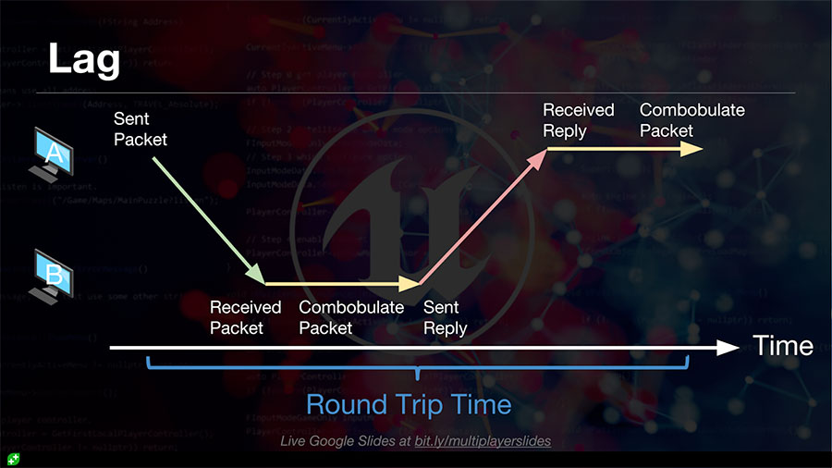
DEALING WITH LAG
Lag is a horrible thing if you have experienced it as a gamer. Dealing with it is also a nightmare if you’re a game programmer.
Lag is introduced by all the processing that goes on between you and the server.
Routers have to process and copy your packets around, the server itself needs to do calculations and then there’s that pesky speed of light!
So in practice, it might take 100ms (in the bad times) to get a reply from the server.
100ms is an unacceptable delay between pressing a key and seeing the results of your actions. It makes games unplayable. For this reason, there are lots of techniques that can be used to make sure the clients see a much smoother and lag free view of the game. Which technique you use depends on the gameplay experience you want to create, as all of them require some trade-offs.

Slide 29
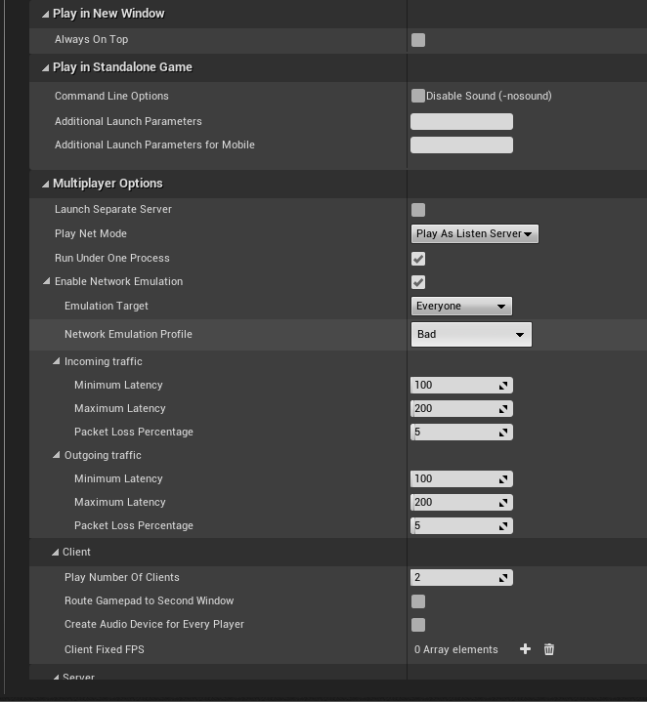
LAGGY BEHAVIOUR TESTING
In fact, the CharacterMovementComponent implements one of these techniques to ensure the FPS example works exceptionally well, even with high lag.
However, if you want a custom type of movement, you will need to know how to implement these for yourself.

Slide 30
HINTS:
Consider implementing a server-client version of UpdateMovement params replacing ChangeRunPressedServer/Multi() function.
HOMEWORK:
STAMINA SYSTEM REPLICATED BY THE SERVER
REQUIREMENTS:
Implement server supervised running and attacking.
Make the stamina system also computed and replicated to all the clients.
Test with 4 players.

Slide 31
Conclusion
Questions?

